Slide 1
General Morphing

Slide 2
Multiple Approaches
Affine
Bilinear Transformation
Perspective

Slide 3
Affine Transformation

Slide 4
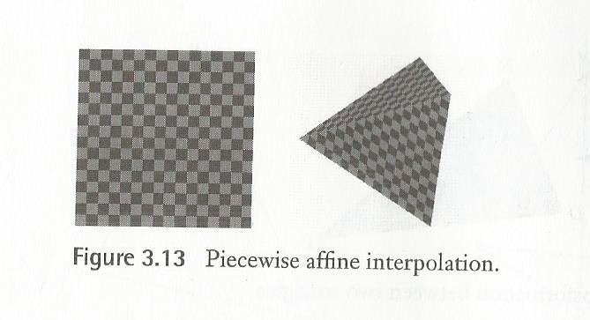
Not the Best Solution
Works well On Triangles to Triangles
Done Piecewise on other shapes
The transformation is Continuous
But there is discontinuity in the first derivative

Slide 5
Bilinear and Perspective
The two useful ones

Slide 6
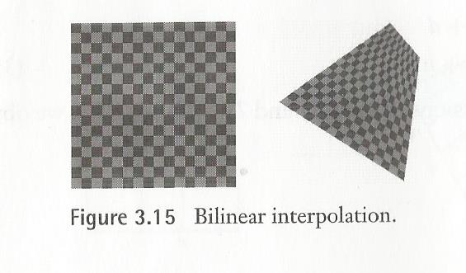
BilINear
Pros
Non-planar – useful for mapping none 2-D things
Very General
Cons
Non-planar – none vertical or horizontal lines map to quadratic curves
Quadratic in the Inverse

Slide 7
Perspective Transform
Pros
uses matrix operations much like the affine Transformations
Planar like the Affine Transformations – does Quadrilateral transforms well
Lines remain lines - though they foreshorten distant lines to a vanishing point, renders a nice realistic image
Cons
Not as general as bilinear

Slide 8
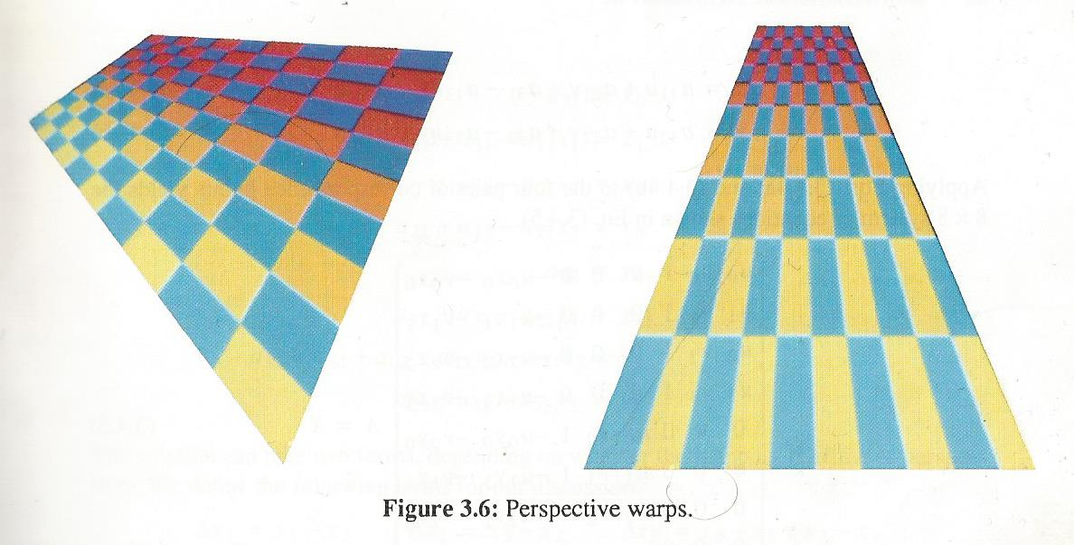
Doing the Perspective Transform

Slide 9

The Forward Equations
$\left[x^{′}, y^{′},w′\right]= \left[u,v,w\right] A$
$x= \frac{x′}{w′}= \frac{a_{11}u+a_{21}v+a_{31}}{a_{13}u+a_{23}v+a_{33}}$
$y= \frac{y′}{w′}= \frac{a_{12}u+a_{22}v+a_{32}}{a_{13}u+a_{23}v+a_{33}}$

Slide 10
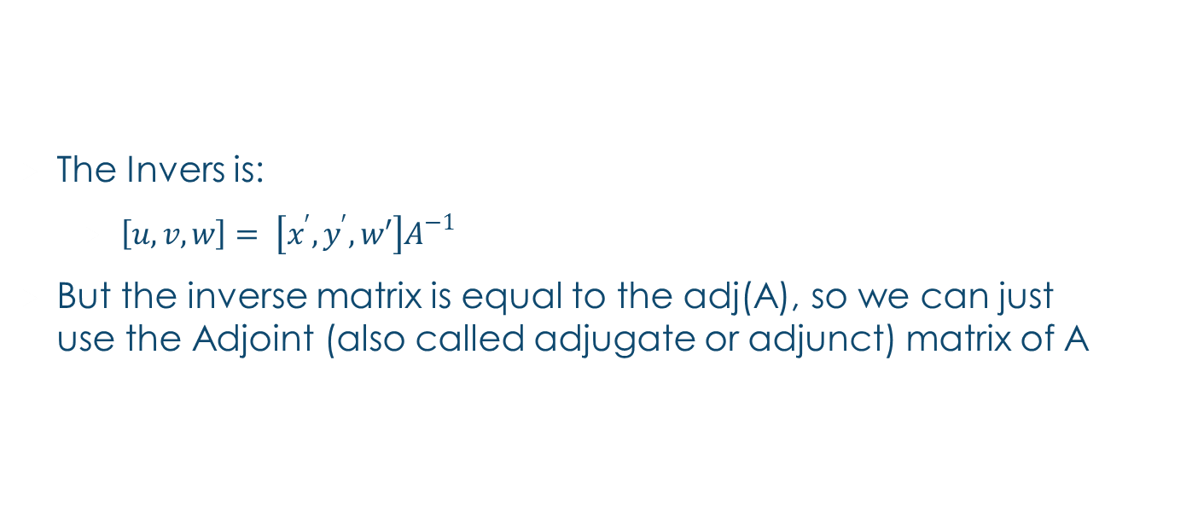
The Inverse Equations
The Invers is:
$\left[u,v,w\right]= \left[x^{′},y^{′},w′\right]A^{−1}$
But the inverse matrix is equal to the adj(A), so we can just use the Adjoint (also called adjugate or adjunct) matrix of A

Slide 11

Inferring PerSpective Transformations
$a_{33}=1$
$x= a_{11}u+ a_{21}v+a_{31}−a_{13}ux− a_{23}vx$
$y= a_{12}u+ a_{22}v+a_{32}−a_{13}uy− a_{23}vy$

Slide 12

Case 1: Square to Quadrilateral
First some Definitions:
$∆x_{1}= x_{1}− x_{2}$ , $∆x_{2}= x_{3}− x_{2}$, $∆x_{3}= x_{0}− x_{1}+ x_{2}− x_{3}$
$∆y_{1}= y_{1}− y_{2}$, $∆y_{2}= y_{3}− y_{2}$, $∆y_{3}= y_{0}− y_{1}+ y_{2}− y_{3}$

Slide 13

$a_{11}=x_{1}−x_{0}+a_{13}x_{1}$
$a_{21}=x_{2}−x_{1}+a_{23}x_{3}$
$a_{31}=x_{0}$
$a_{12}=y_{1}−y_{0}+a_{13}y_{1}$
$a_{22}=y_{2}−y_{1}+a_{23}y_{3}$
$a_{32}=y_{0}$
$a_{13}=0$ OR $\frac{\left|\begin{matrix}∆x_{3} & ∆x_{2} \\ ∆y_{3} & ∆y_{2}\end{matrix}\right|}{\left|\begin{matrix}∆x_{1} & ∆x_{2} \\ ∆y_{1} & ∆y_{2}\end{matrix}\right|} if ∆x_{3}\text{ != 0 }\text{and} ∆y_{3}\text{ != 0}$
$a_{23}=0$ OR $\frac{\left|\begin{matrix}∆x_{1} & ∆x_{3} \\ ∆y_{1} & ∆y_{3}\end{matrix}\right|}{\left|\begin{matrix}∆x_{1} & ∆x_{2} \\ ∆y_{1} & ∆y_{2}\end{matrix}\right|}if$ $∆x_{3}$ != 0 and $∆y_{3}$ != 0

Slide 14
Case 2: Quadrilateral to Square
Do Case 1 then find the inverse matrix (the Adj of the A you get)

Slide 15
Case 3: Quadrilateral to Quadrilateral
Do case 2 then Case 1

Slide 16
References:
Warping and Morphing of Graphical Objects
by Jonas Gomes, Lucia Darsa, Bruno Costa, Luiz Velho
Digital Image Warping
by George Wolberg
Digital Image Processing
by Rafael C. Gonzalez , Richard E. Woods

